Slide 1
Deconstructing IoT- Role of Middleware and Protocols
Abhishek
Notes:
Module 1 and 2

Slide 2
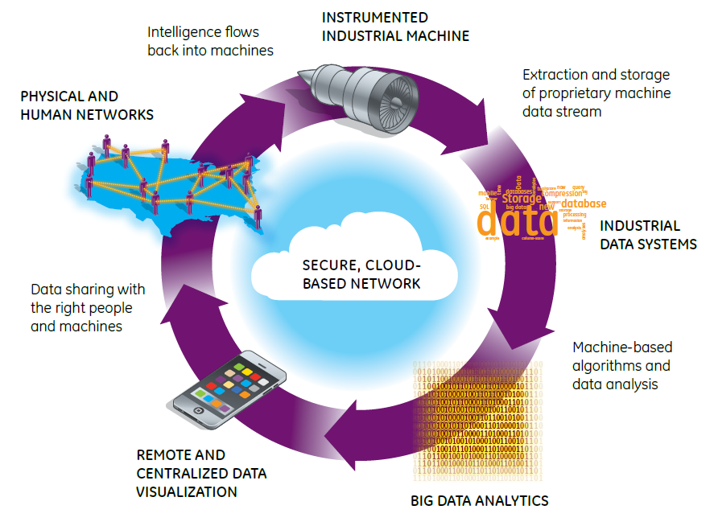

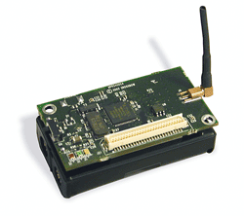

Deconstructing Smart IoT Systems
Human Layer
Environment
Sensors
Human Networks
Data Streams
Smart Application Layer
Decision Support Systems
Data Sharing
Platform
Networking Layer
Physical System and Sensors
UI and Information Presentation
Decision Support Systems: Big Data Analytics

Slide 3
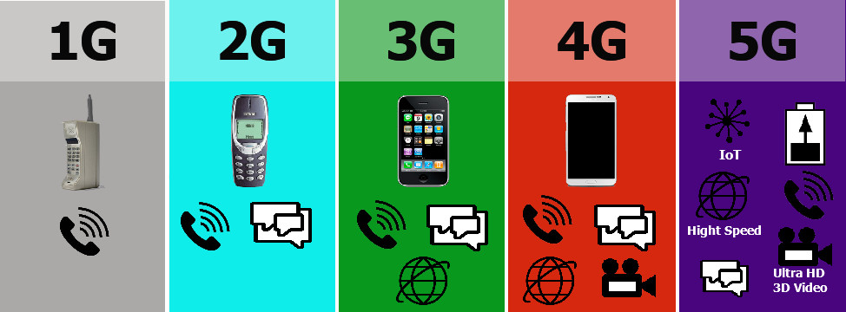

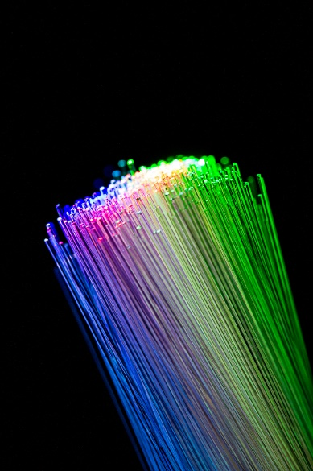
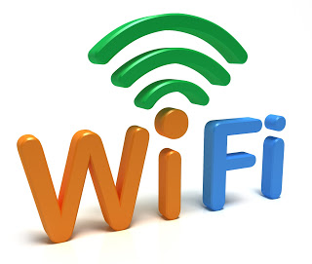
Networking Layer
Human Layer
Smart Application Layer
Decision Support Systems
Networking Layer
Physical System and Sensors
The data from the IoT Sensors have to be moved in real-time to a computation backend for analysis.
Must deal with a range of networking technologies
The tradeoff is between throughput, cost, and timeliness and reliability of data transfer
Notes:
Explain the concept of protocol.

Slide 4
IoT Low Energy Physical layer

Slide 5
IoT Middleware
IoT environments are often resource-constrained and hence involve low bandwidth communication
Safe and reliable communications are desired for IoT
Existing protocols can be divided into network-level and data-level protocols
Several different protocols exist, and more are researched on
Source: 15 protocols listed at https://www.ubuntupit.com/top-15-standard-iot-protocols-that-you-must-know-about/

Slide 6
IoT Protocols – Bluetooth Low Energy
Provides significantly reduced power consumption and cost while still maintaining the range of traditional Bluetooth (100 meters/300 ft)
Uses the same 2.4 GHz spectrum as the classic Bluetooth but uses different channels
0.27 to 1.37 Mbits/sec throughput
0.01 to 0.5 Watts power consumption
128 bit AES security
Goal is to support months to years of operational capabilities on a single button cell
A special interest group (SIG) maintains the BLE specification
Applications built using the Generic Attribute Profile (GATT), which specifies short pieces of data can be sent/received over low energy link
Additional domain-specific profiles are available per industry vertical, e.g., healthcare, fitness
BLP (blood pressure profile), HRP (heart rate profile), WSP (weight scale profile)

Slide 7
IoT Protocols - Wifi
IoT applications may involve anywhere from short messages to continuous data streams, and short range communication (e.g., wearables) to communication over several kilometers (e.g., weather, agriculture); power constraints still exist irrespecive
WiFi provides low cost and ubiquitous deployment
Traditional WiFi (i.e., 802.11 a/b/g/n/ac) have high power consumption, smaller range, and is vulnerable to spectrum congestion
2 emerging IEEE standards: WiFi HaLow:802.11ah and WiFi HEW: 802.11 ax and ay
HaLow uses 900 MHz ISM band to provide extended range (almost double that of traditional WiFi) at low power consumption;
Goal is to support applications like smart homes, connected cars, smart city, etc
however it needs specialized access points and chip vendors are slow in bringing the technology to market
High Efficiency Wireless (HEW) operates in all band spectrums from 1 to 7 GHz with top speeds of 11Gbits/sec
WiFi Alliance calls it WiFi 6
Meant to operate with high performance despite many connected devices
Improved power efficiency

Slide 8
IoT Protocols - ZigBee
Based on the IEEE 802.15.4 specification for personal area networks
Low cost, low power wireless mesh network standard
Operates in the ISM band, usually at 2.4 GHz with data rates up to 250 kilobits/sec
Intended to be simpler and less expensive that Bluetooth
10 to 100 meters line-of-sight communication range
Battery life must be at least 2 years to be certified as ZigBee
Not suitable for nodes with high mobility
Application areas are numerous
Home automation, industrial control, medical data collection, smoke/fire alarms, remote microphone control, building automation, etc.
Application profiles per application area
(www.zigbee.org)

Slide 9
IoT Protocols – LoRaWAN
Long Range Wide Area Networks (LoRaWAN) is a low power wide area wireless networking meant to connect IoT devices over networks of multiple different scales providing bi-directional communications
Typically deployed in “star of stars” topology where gateways relay messages between end devices and a centralized server
Gateways convert radio frequency packets into IP packets and vice versa
LoRa is the long range physical layer that enable single hop link between end devices and gateways
Proprietary physical layer, however, an alliance exists
LoRaWAN provides media access and network layer protocols above LoRa
Communication range over 10 kms, however, at smaller data rates (50 kbps)
Not useful for building real-time applications
https://lora-alliance.org/about-lorawan

Slide 10
IoT Protocols – LPWAN/SNOW
Low Power Wide Area Network (LPWAN)
Sensor Networks over Whitespaces (SNOW)
LPWAN offers low power, long range, low cost connectivity for IoT devices which can be realized in various kinds of physical layers
SNOW is a LPWAN technology borne out of academic research that exploits the unused spectrum of TV channels – the so called whitespaces – for long range, low power communication
ISM bands are often crowded while whitespaces are not, and in fact offer a wider spectrum
Practical deployment described in http://www.cs.wayne.edu/saifullah/iotdi19.pdf

Slide 11
IoT Protocols – Z-Wave
Wireless communication protocol meant primarily for home automation
Mesh network with low energy radio waves and no coordinator node
There is a Z-Wave alliance (https://z-wavealliance.org/)
Over 100 million products sold
Found in hotels, cruise ships, alarm companies, etc
No interference from WiFi, Bluetooth, etc
Meant to send short sized messages on half-duplex channels
Range: 30 meters indoors; 100 meters outdoors
Maximum nodes: 232 in a mesh
https://www.z-wave.com/

Slide 12
IoT Protocols – SigFox
Rolling out a global IoT network
Software-based communication where all the complexity is managed in the Cloud rather than the devices
Uses ultra narrow band (200 KHz of publicly available band)
Lightweight protocol, small message sizes
Star network
https://www.sigfox.com/en/sigfox-iot-technology-overview

Slide 13
IoT Protocols – NFC (Near Field Communications)
For contactless communication between devices like smartphones
One can just wave one device over another device that is also NFC-enabled and information can be transmitted between them without the need for connection setup
Essentially, a radio frequency current is established between the two communicating devices
NFC is a subset of RFID and uses 13.56MHz frequency
A typical communication involves a “reader” or “interrogator” node communicating with a “passive” node
Useful in boarding subway trains, paying bills in grocery stores, etc all from a single device
Used in Apple Pay, Android Pay, Samsung Pay
NFC-based payments are dynamically encrypted making them secure
EMV (Europay, Mastercard and Visa) is different from NFC and is the credit card chip technology
http://nearfieldcommunication.org

Slide 14
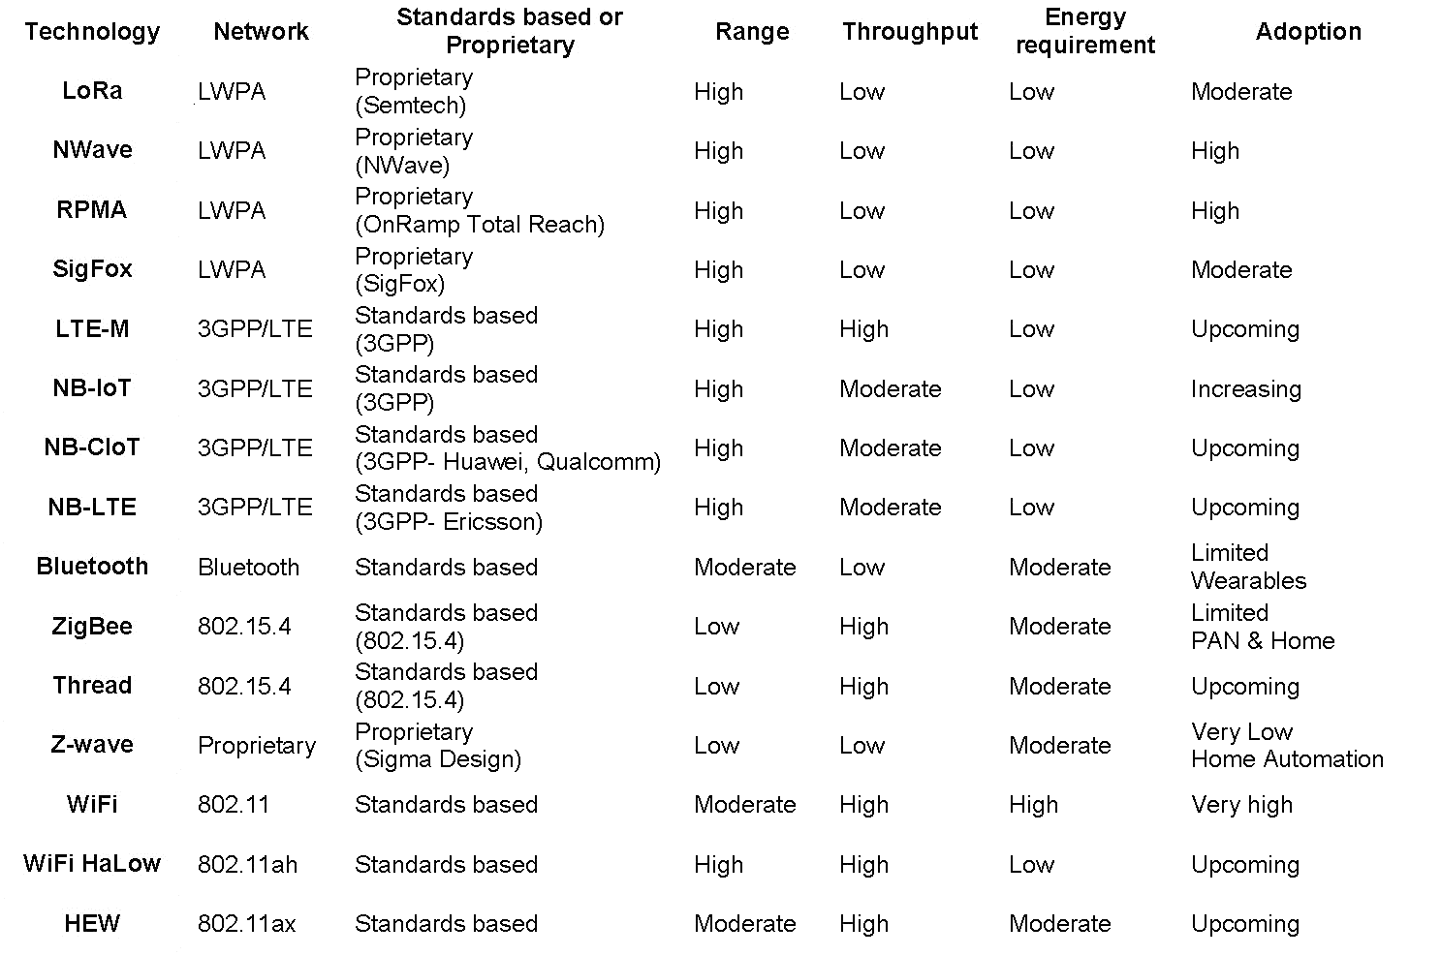
IoT Protocols – Comparison
Source: https://www.networkworld.com/article/3196191/wifi-s-evolving-role-in-iot.html
Notes:
Ask Marc to say that right now LoRA

Slide 15
IoT Middleware

Slide 16
What is middleware
Distributed applications written with socket can become cumbersome.
There are a few problems that must always be solved.
Hardwiring target addresses – a client needs to know the server IP
Typical protocol is A sends data to B, then B replies while A waits and then then A responds back.
Data marshalling problem. How do you decide what is the on-the wire protocol.
Can we abstract away the gory details of the communication from the computation aspect of the distributed application?

Slide 17
What is middleware
Think of middleware as a combination of services [external processes] and libraries that solves the problems of slide 2.
Services provided can be
Discovery – automatic wiring of clients and servers
Improved fault tolerance and restart of dead processes.
End to End Quality of service Management, etc.
The library can provide
Core communication design patterns [we will talk about it]
Automatic encoding and decoding of messages
Provide callback for invoking a function when data is received.
Advanced buffering capabilities to allow handover of certain tasks to the middleware
For example, connection set is managed by several threads running in background in zero MQ

Slide 18
Communication Patterns
Communication patterns can be generally divided into two groups
Asynchronous Interaction – The parties do not wait for a response and computation can start without waiting for communication to finish.
Synchronous Interaction - Computation is blocked to ensure that the communication finishes.
Asynchronous Interaction
Publish/Subscribe
Async request reply
Synchronous Interaction
Request Reply

Slide 19
Publish/Subscribe
Slides based on Content from Andy Gokhale and the paper
Patrick Th. Eugster, Pascal A. Felber, Rachid Guerraoui, and Anne-Marie Kermarrec. 2003. The many faces of publish/subscribe. ACM Comput. Surv.35, 2 (June 2003), 114-131. DOI=http://dx.doi.org/10.1145/857076.857078

Slide 20
Publish-Subscribe
Provides decoupling among producers (called publishers) and consumers (called subscribers along three dimensions
Time
They do not have to be up and running at the same time
Can come and go anytime (like P2P)
Space
They do not need to be aware of each other
Synchronization
Nobody blocks for the other

Slide 21
Advantages of Pub/Sub
The 3 dimensions of decoupling enable
Increased scalability
Improved resilience
Reduction in coordination
Suited for asynchronous environments like mobile

Slide 22
Comparing other Communication Models
Message passing
Low level approach to send/receive messages
Remote procedure call
Builds over message passing
Appears as though a normal procedure call is made but it is a remote invocation
JAVA RMI, CORBA request-response, SUN RPC, DCOM
Tuple spaces (distributed shared memory)
Supports the anonymous, decoupled messaging across time and space BUT not the synchronization decoupling that pub/sub provides
Message queuing/Message Oriented Middleware
More of an implementation detail of the message passing protocol

Slide 23
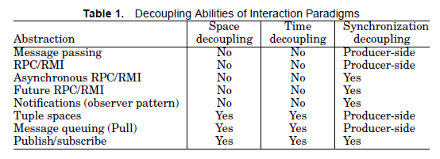
Comparison Chart
Chart taken from the paper (provides a nice comparison)
Notice how all three traits are supported by pub/sub only
Tuple spaces and message queue are almost there

Slide 24
Key components of Pub/Sub System
Publishers : Publishers generate event data and publishes them.
Subscribers : Subscribers submit their subscriptions and process the events received
P/S service: It’s the mediator/broker that filters and routes events from publishers to interested subscribers.

Slide 25
Classification of Pub/Sub Architectures
Peer-to-Peer model
Each node can be publisher, subscriber or broker.
Subscribers subscribe to publishers directly and publishers notify subscribers directly. Therefore they must maintain knowledge of each other.
Complex in nature, mechanisms such as DHT and CHORD are employed to locate nodes in the network.
E.g. distributed event service

Slide 26
Basic Terminology
Event
Is the information generated by the publisher that must be delivered to the subscriber
Notification
Is the act of alerting the subscriber of an event of interest to that subscriber
Event service
Manages the storage of events and delivery of events from publisher to subscribers
It serves as a proxy for both the publisher and subscriber

Slide 27
Types of Pub/Sub Models
Topic-based
Publishing/subscription is based on events that are named or have an ID
Content-based
Publishing/subscription is based on the contents of the event
Type-based
Like topic-based but provides a programming language-level type instead of some name
Data-centric pub/sub is another variant that uses topics, which are typed, and also deals with the content
Kind of a hybrid of the three approaches
e.g., OMG’s Data Distribution Service
We shall study DDS in some detail later

Slide 28
Topic-based Pub/Sub (1/3)
Every topic has a unique name (e.g., a URL)
Interfaces used by publisher and subscriber are simple
Topic-based pub/sub is very similar to group communication and membership, e.g., Isis
Focus of group communication is more on consistency management
Hierarchical addressing is supported
i.e., topics can form hierarchy through containment
In contrast, group comm uses flat addressing

Slide 29
Topic-based Pub/Sub (2/3)
Each topic maps to a (virtual) channel
Think of it as a virtual private n/w carrying data only between authorized entities
Each topic is identified by a key
A database oriented concept
Strings are usually used as keys (but not a requirement)
Keys help to divide the event space into granularities based on that key
Managing events, the publishers and subscribers becomes easy (less cluttering)

Slide 30
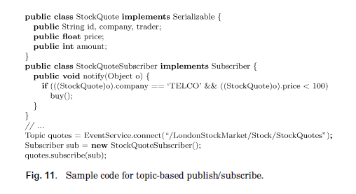
Topic-based Pub/Sub (3/3)
Notice how the filtering of the event is the responsibility of the subscriber
Here is how a subscriber subscribes to a specific topic
In the sample from the paper, note how the subscription captures a specific event (i.e., topic) based on its ID (here a URL)
Subscriber will receive everything from that topic
Any filtering is the responsibility of the subscriber
DDS provides advanced capabilities for filtering (borrowing concepts from content-based) because of its data-centric nature

Slide 31
Content-based Pub/Sub (1/2)
Topic-based scheme is simple but it is static, and lacks expressive power
Filtering is the responsibility of the subscriber
Content-based provides finer granularity by subscription based on the actual content of the event
Subscription for content is specified using filters
String-based, template-based, executable code
Complex filters can be constructed using comparison and logical operators
More sophisticated pub/sub implementation and may incur more runtime overhead
Siena is a good example of content-based pub/sub
See http://www.slideshare.net/dsrosenblum/contentbased-publishsubscribe-networking-a-reassessment-keynote-talk-at-doa-2005

Slide 32
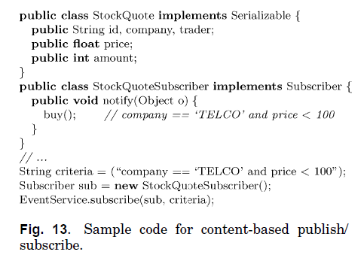
Content-based Pub/Sub (2/2)
Notice how the filtering of the event is the responsibility of the pub/sub mechanism and not the subscriber
In the sample from the paper, note how the subscription describes the content
Subscriber will receive only that event
Any filtering is the responsibility of the pub/sub system as opposed to the subscriber (in the case of topic-based)

Slide 33
Type-based Pub/Sub (1/2)
Similar to topic-based
Recall that topics were identified by names in the form of a key
However, instead of the “type unsafe” name-based approach, events now become “types” in the programming language
Improves safety; compile-time error checking can be done as opposed to at runtime

Slide 34
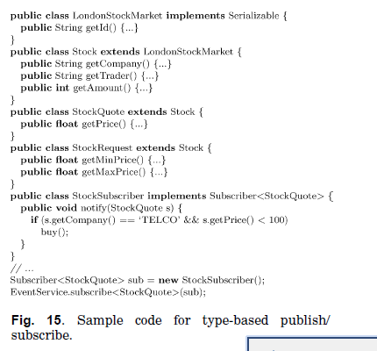
Type-based Pub/Sub (2/2)
In the sample from the paper, note how the subscription captures a specific event (i.e., topic) based on its type
Any filtering is the responsibility of the subscriber as in topic-based
But we get type safety
Notice how the subscription is based on a type

Slide 35
Implementation Issues in Pub/Sub
At least 3 concerns raised in the paper
How exactly are events implemented?
What impact does the communication channel (media) have?
What about quality of service (QoS)?
Choice of each has an impact on
Flexibility, reliability, scalability, performance

Slide 36
Implementing Events
Message-based
Messages are self describing, i.e., header indicating what message it is and a payload
Messages are sent from one entity to another
The receiving entity must make sense of what is received
Invocation-based
Based on making an invocation (like RPC) on a target object
Allowable invocations are those described in interfaces and which becomes the binding contract

Slide 37
Event Routing – uses Brokers
After filtering the events, the broker/brokers must route the events to the corresponding subscribers.
Can be done in the following ways:
Unicast
Multicast
Server push/ client pull

Slide 38
Event Routing
The broker makes the decision: how to route the message to the subscriber.
Several optimization schemes are available.
Profile forwarding scheme – brokers only forward the event to their neighbor broker which fulfill their subscription
Filtering the total covering of the subscription of the system – accept publisher events only if a subscriber has subscribed this event.

Slide 39
Implementing Communication Media
Issues to deal with
Who manages the events and subscriptions?
Mediator or broker-based approach (makes pub/sub entities simpler but are centralized solutions)
Publishers/subscribers have smart hooks that manage it without the application knowing it
How are publishers and subscribers located and matched?
How are events actually transferred?
Point-to-point (simple but not scalable)
Multicast (scalable but hard to implement in the context of all the filtering, etc)

Slide 40
Quality of Service (QoS)
Must be provided along the 3 dimensions of decoupling
Persistence of events
becomes important for time decoupled publishers and subscribers
Who is responsible? Depends of approach used (e.g., broker-based or end-system based
Priorities of events may be important
How to reduce inversion of priorities?
Transactional semantics for group of events
Reliability
OMG Data Distribution Service supports several QoS mechanisms that we will study later

Slide 41
Zero MQ Example

Slide 42
MQTT Example
Note that MQTT is a brokered system

Slide 43
MQTT
MQTT (Message Queuing Telemetry Transport) is a simple and lightweight, publish/subscribe messaging protocol for machine to machine/IoT communications
Became an OASIS standard
Uses a broker for communication between publishes and subscribers
14 different message types supported
Quality of Service can be specified on the connection: “at most once”, “at least once” and “exactly once” semantics
TCP Port 1883 reserved, and 8883 using SSL
(www.mqtt.org)

Slide 44
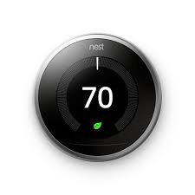
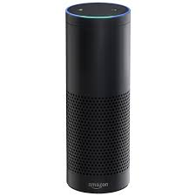
Consider an IoT Application
Set Temperature to 70
Temperature = 70

Slide 45
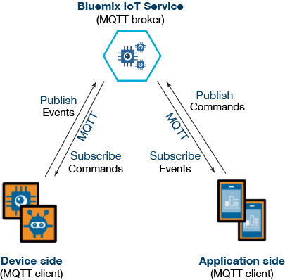
MQTT: Message Queuing Telemetry Transport

Slide 46
MQTT: Pub/Sub
Clients connect to a “Broker”
Clients subscribe to topics eg,
client.subscribe(‘toggleLight/1’)
client.subscribe(‘toggleLight/2’)
client.subscribe(‘toggleLight/3’)
Clients can publish messages to topics:
client.publish(‘toggleLight/1’, ‘toggle’);
client.publish(‘toggleLight/2’, ‘toggle’);
All clients receive all messages published to topics they subscribe to
Messages can be anything
Text
Images
etc

Slide 47

MQTT Hypothetical Light Switch
Cell Phone
Broker
client.publish(‘lightSwitch/1’, ‘toggle’)
‘toggle’
WiFi Switch
Toggle Switch

Slide 48
DDS (Data Distribution Service)
Object Management Group (OMG)’s specification for data-centric, topic-based publish-subscribe communication
Goal is to support real-time publish/subscribe communication
Several different quality of service configuration knobs are provided
Publishers and subscribers are matched based on topic equivalence and offered-vs-requested QoS model
i.e., offered QoS by publisher dominates the requested QoS properties by subscribers
DDS introduces a global data space which is used by applications to share information
Global data space is provide by the DDS’ Data-centric Publish-Subscribe (DCPS) layer
https://www.dds-foundation.org/)

Slide 49
AMQP
Advanced Message Queuing Protocol (AMQP) is a message-oriented middleware that provides a binary wire-level protocol
It supports messaging, routing of messages either via point to point or publish/subscribe, reliability and security
Its design is such that it can be used in IoT applications
A Well-known implementation is RabbitMQ
https://www.amqp.org/

Slide 50
Other Patterns

Slide 51
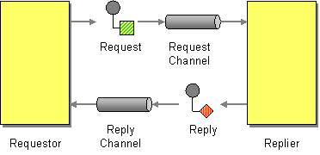
Request Reply Pattern

Slide 52
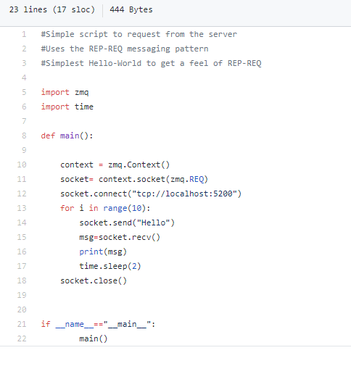
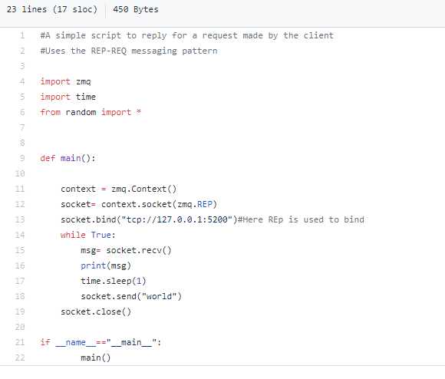
ZERO MQ Request reply example
https://learning-0mq-with-pyzmq.readthedocs.io/en/latest/pyzmq/patterns/client_server.html

Slide 53
Asynchronous Request Reply
The client does not wait for the server to respond. Rather it attaches a callback to be executed when the message arrives.

Slide 54
REST Services
REpresentational State Transfer
A “request” is sent to a server via URL
Eg. http://api.example.com/resources/user/1036721?name=something
Response is usually text in HTML, XML, or JSON
Great if your asking for something
What about “push”
Eg. Server wants to tell device to do something

Slide 55
HTTP: RESTful Hypothetical Light Switch
Cell Phone
Server
api.example.com/turnoff
api.example.com/shoulditurnoff
WiFi Switch
Should I turn off?
No
Process Response
Yes
Turn off

Slide 56
CoAP (Constrained Application Protocol)
Specialized application-level protocol for constrained devices
Specified in RFC 7252
Goal is to allow constrained devices to talk to each other on the same constrained network, or to other devices in other constrained networks connected by the Internet, or to other nodes on the Internet
It is meant to be very simple, low overhead and supporting multicast all of which are key requirements for IoT
CoAP mapping to HTTP is available for ease of integration with the Web and enable RESTful services
A CoAP server typically executes on a constrained device like a sensor, whereas a CoAP client maybe a controller that obtains information from a large number of such servers
Several open-source implementations are available in many different programming languages
https://coap.technology/

Slide 57
ZeroMQ
http://miku.github.io/zeromq-slides/slides.html#slide-8

Slide 58
Resilient Information Architecture Platform for Smart Grid - RIAPS
https://riaps.isis.vanderbilt.edu/

Slide 59
Backend- cloud Services
Notes:
Module 1 and 2

Slide 60
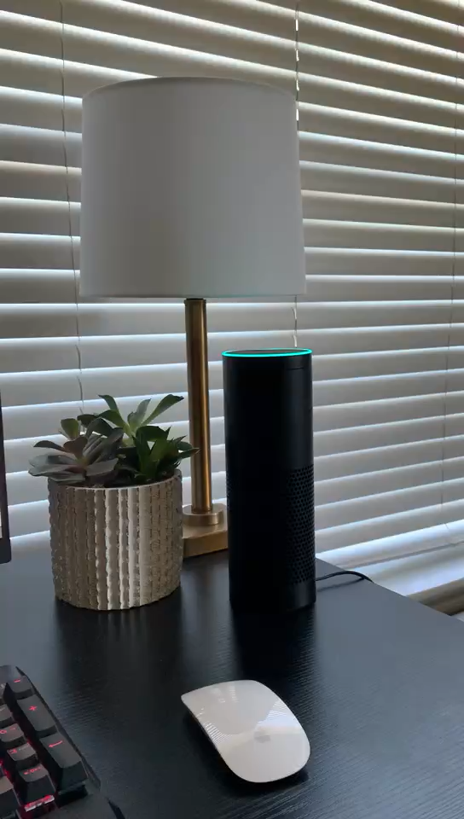
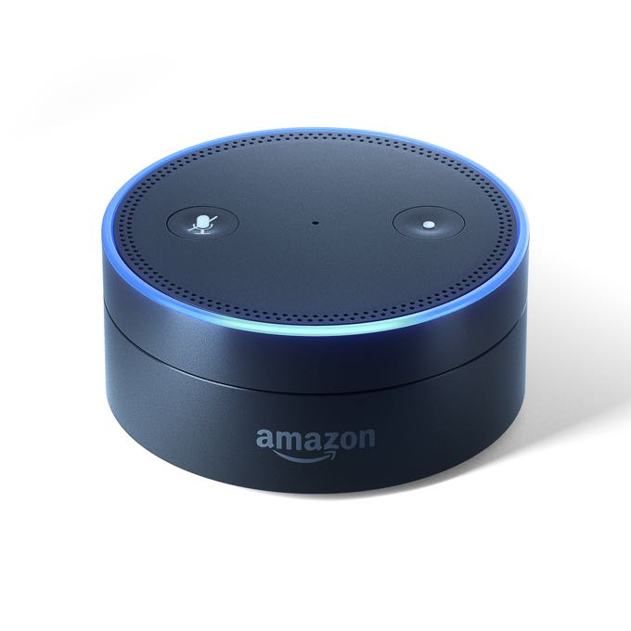






Smart Building – Room Service
Room 101
Ok, let me notify dining room
Order a pizza
Room 101 needs a pizza
Room 101 needs a pizza
We are preparing your foods, thanks for ordering
Pizza is available,
this order has been
confirmed
My receipt
Customer receipt
Light up hue

Slide 61
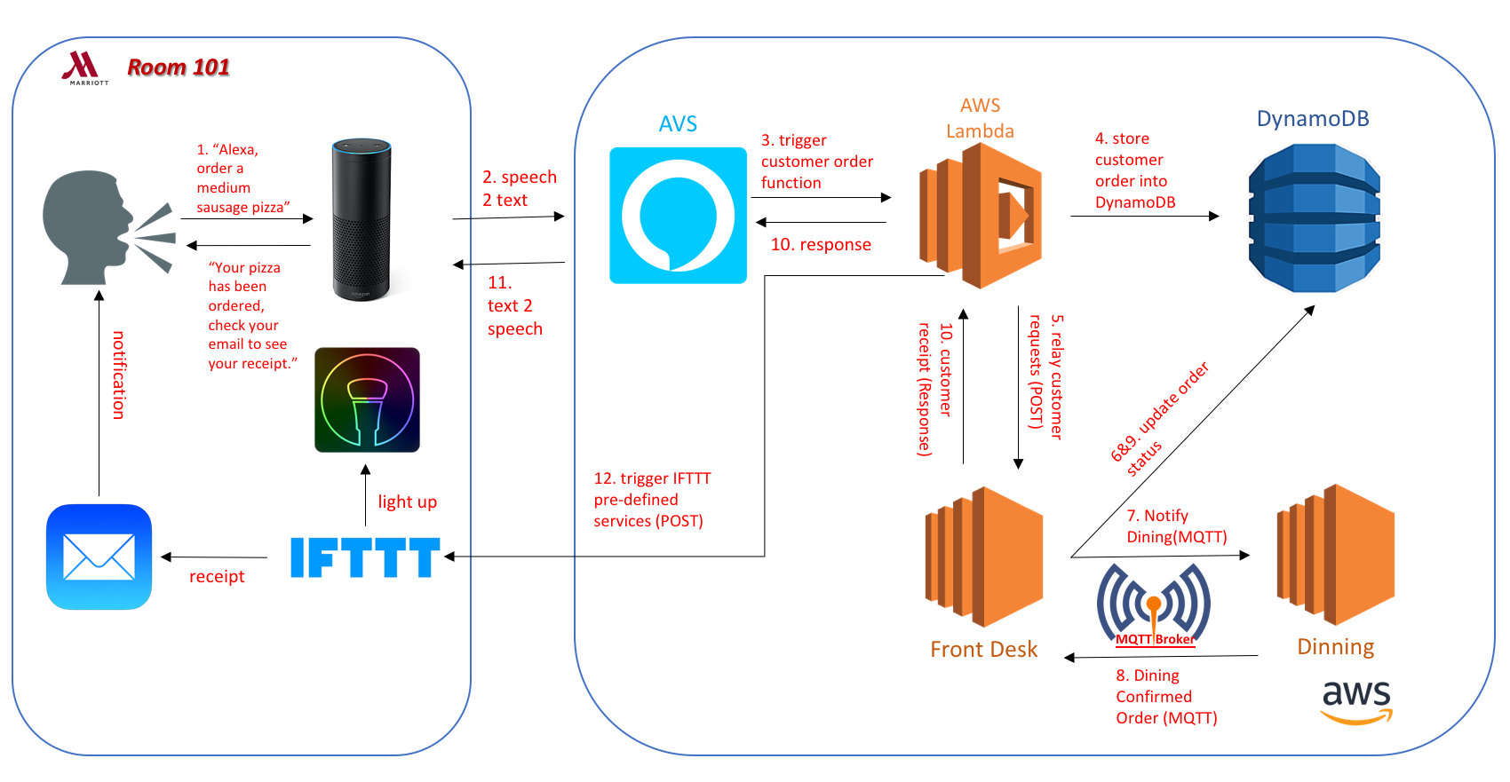
Smart Building – Room Service

Slide 62
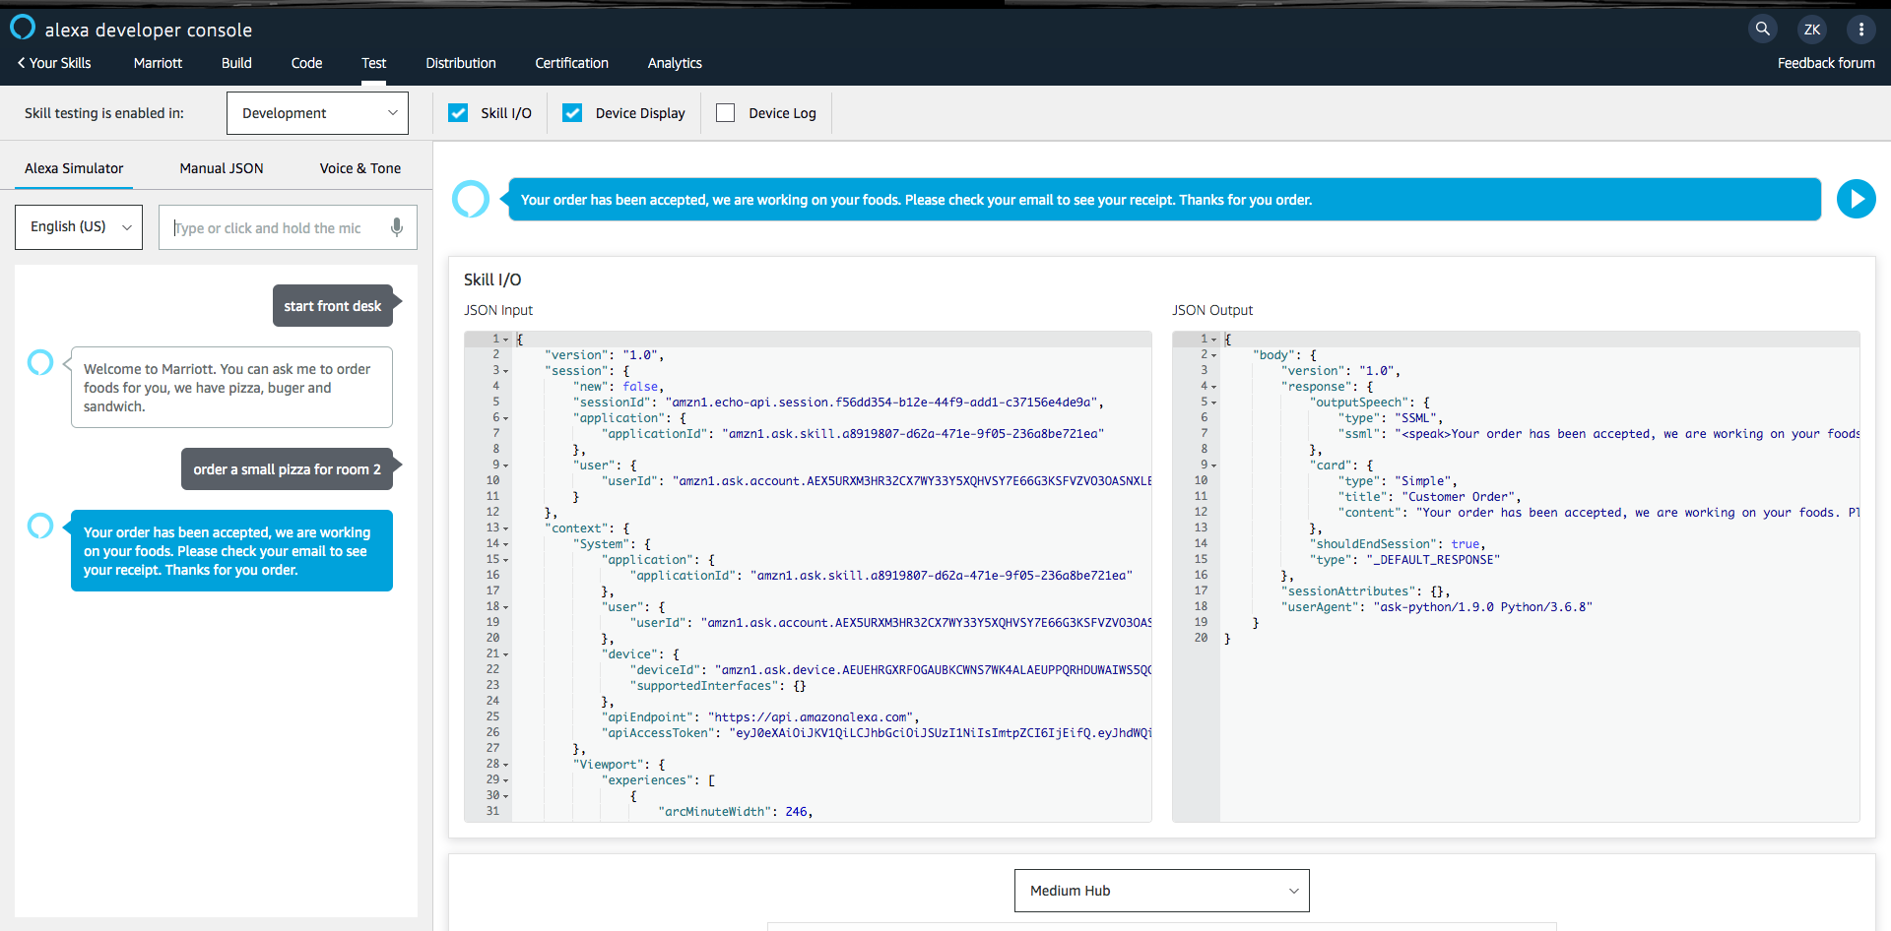
Alexa Voice Service
Convert user’s voice input stream received from Echo to a json object.
Convert Lambda’s json output, which is the response for user’s request, to a voice stream.

Slide 63
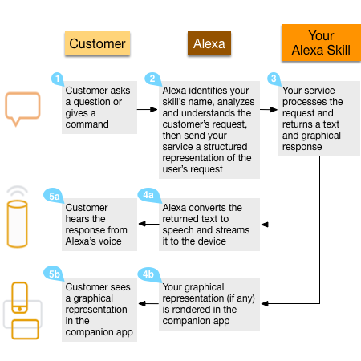
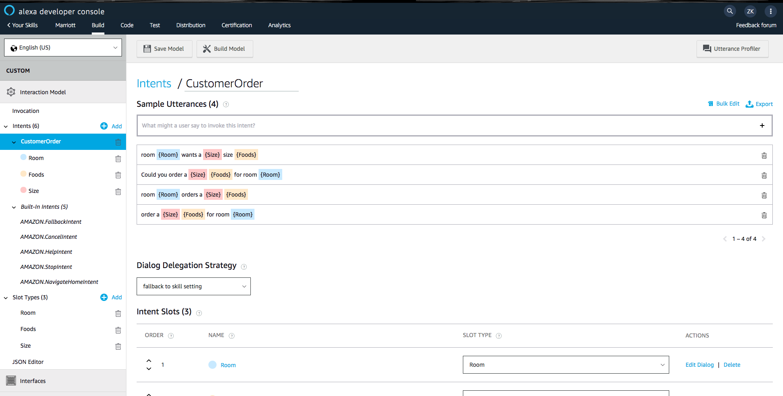
Alexa Custom Skill
Processing Procedures:
Define Alexa Custom Skill:

Slide 64
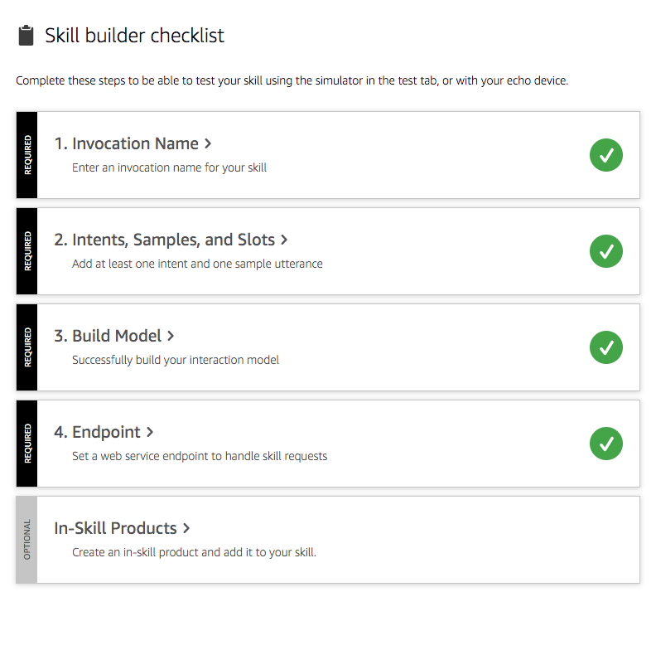
Alexa Custom Skill(2/2)
Key Notions in Alexa Custom Skill
Invocation Name: Few words for invoking your skill, like “Alexa” is the default invocation name.
Intents: similar to an event, such as “clean room”, “order foods”, etc.
Slots: components of an events, for example, in a “order foods” event, user always need to provide “food name”, “room id”, etc, these components are defined as slots in Alexa.
Sample Utterance: a developer defined request format for submitting users’ voice commands. Such as, “Alexa, order a small pizza for room 101”, or you can say “Alexa, room 101 needs a small pizza” Not only request, developers also can define how does Alexa respond them. It’s also sample utterance.
Endpoint: a platform to handle skill requests, such as AWS Lambda.

Slide 65
AWS Lambda
AWS Lambda is an event-driven, serverless computing platform provided by Amazon as a part of the Amazon Web Services. It is a computing service that runs code in response to events and automatically manages the computing resources required by that code.
Two features:
Event-driven: the flow of program is determined by events such as user’s action, in our case, user’s action is their voice input
Serverless computing: it does not need a server. It means servers are managed by cloud provider like AWS, Azure, AliCloud, etc. Developers don’t need to manage the server by themselves and resources are dynamically allocated by cloud provider.
Servers are short-lived and get created on-demand.
AWS uses it to consolidate idle physical resources.

Slide 66
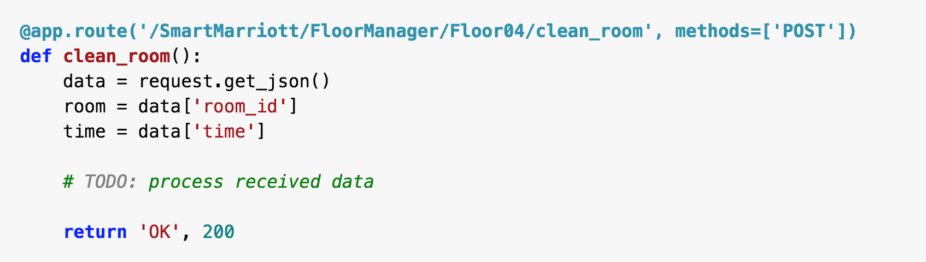
Flask
A popular Python web framework; in other words, it’s a third-party Python library for developing web applications.
Assuming your URL is: http://129.11.22.33:5000/customer_order
And you send a json object to the server using the POST method.
What does flask do?

Slide 67
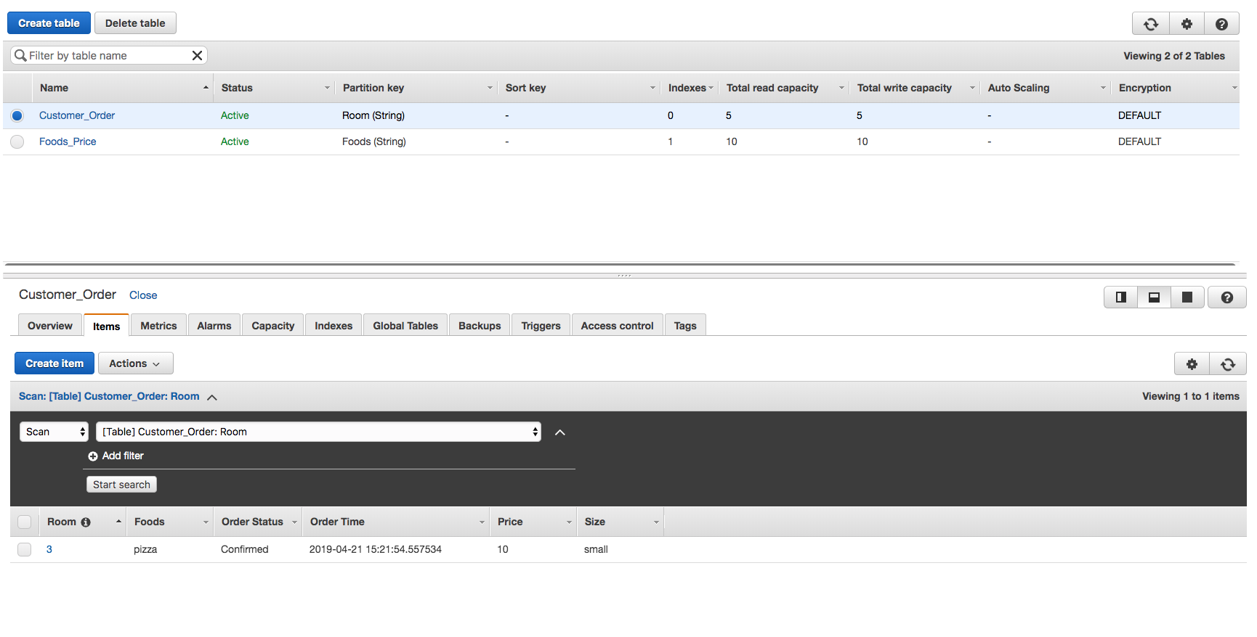
DynamoDB
Amazon DynamoDB is a key-value and document NoSQL database that delivers single-digit millisecond performance at any scale.

